Slide 1
LEAD SCORE ASSIGNMENT
Group Members:
Soumyadip Bhattacharyya
Shubham Chourasia
Anshul Srivastava
Bhagyashree Nolkha

Slide 2
Abstract
Objective
Assigning a lead score on the basis of the user behaviour
Analysis Step
Exploratory Data Analysis & Outliers handling
Logistic Regression
Source
UpGrad’s Lead Data

Slide 3
Problem Solving Methodology
Data Extraction
Understanding Data
Data Preparation
Understanding Business Objective
Data Modelling & Analysis
Data Evaluation
Data Visualization

Slide 4
Analysis Steps
Analysis steps taken are as follows :
Importing Dataset and inspecting the dataset
Exploratory data analysis (EDA) to understand data, handle all NA values, outliers etc.
Creating Dummy variables
Correlation matrix to look for multicollinearity
Handling Outliers by choosing only data points between 5-95 percentile
Test-Train split of the dataset
Scaling Features using Standard Scaler method
Model Building (Logistic Regression) using stats models
Features Selection using RFE top 15 features were selected
Dropping features with p-values higher than 0.05 & VIFs greater than 5
Re-running model until a stable solution is reached
Plotting ROC curve to choose optimum cut-off for conversion probability
Calculation of Specificity, sensitivity, accuracy, precision & recall. Optimising on precision to be above 80%
Final precision attained is 0.81 on test set

Slide 5
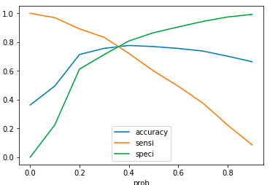
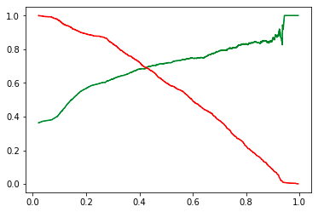
Choosing 0.75 probability cut-off in order to get above 80% precision

Slide 6
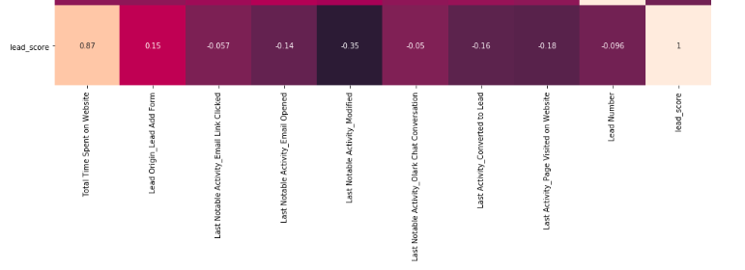
Correlation Snapshot for Lead Score
Total Time Spent, Lead Origin & Last Notable Activity are major features responsible for conversion
Total Time spent has a strong positive correlation (+0.87) with Leads score
Amongst Last Notable Activity columns values, Modified has a moderate negative correlation with lead score

Slide 7
Recommendation
Higher Time Spent on website shows higher intent for conversion hence, focus should be on providing as much as possible relevant information on the website & improving User experience
Optimisation of digital campaigns on users who have opened Lead Add Form in order to convert users who haven’t filled the lead through remarketing campaigns
Lead Notable Activity being Modified drives down conversion intent hence, sales team need to work on getting & meeting all requirements in one go

Slide 8
Thank You!

